Slide 1


Slide 2
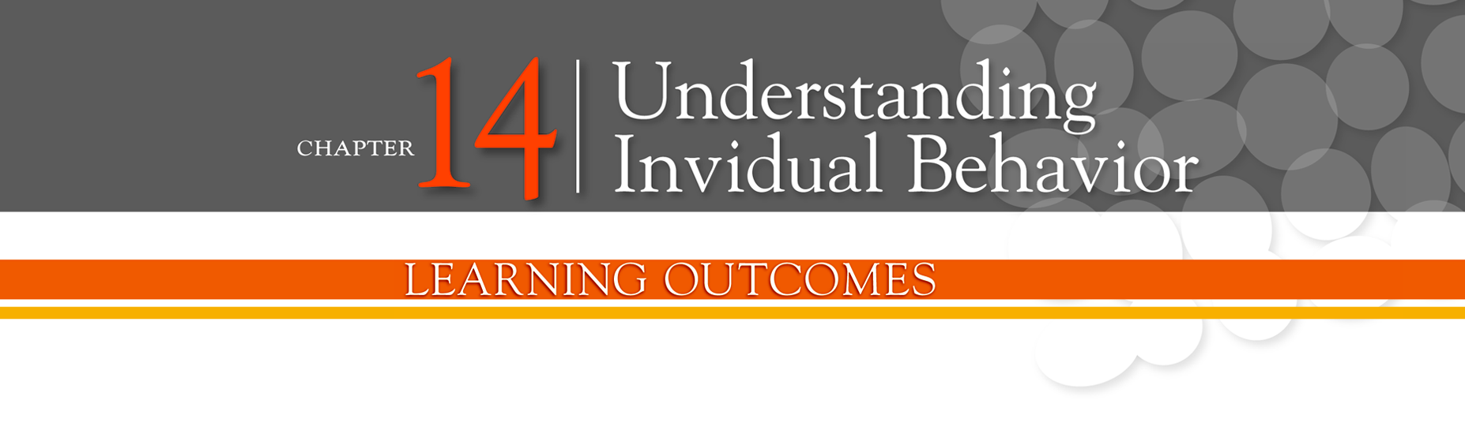

Identify the focus and goals of individual
behavior within organizations
Explain the role that attitudes play in job performance
Describe different personality theories
Describe perception and factors that influence it
Discuss learning theories and their relevance in shaping behavior
Discuss contemporary issues in organizational behavior

Slide 3
Focus of Organizational Behavior
Behavior - the actions of people.
Organizational behavior - the study of the actions of people at work.

Slide 4
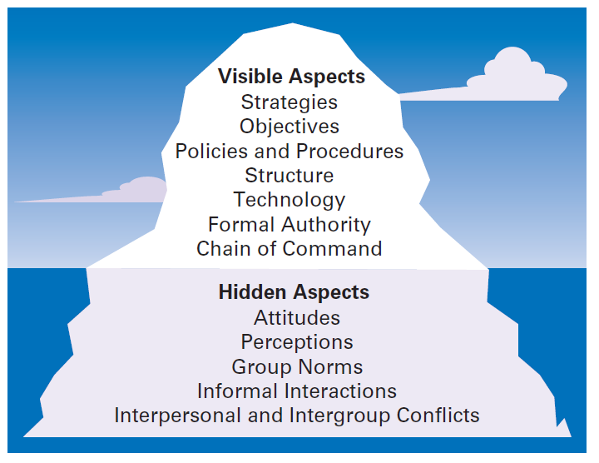
Exhibit 14-1: Organization as Iceberg
Notes:
One of the challenges in understanding organizational behavior is that it addresses issues that aren’t obvious. Like an iceberg, OB has a small visible dimension and a much larger hidden portion. (See Exhibit 14-1.)

Slide 5
Goals of Organizational Behavior
Employee productivity - a performance measure of both efficiency and effectiveness.
Absenteeism - the failure to show up for work.
Turnover - the voluntary and involuntary permanent withdrawal from an organization.

Slide 6
Goals of Organizational Behavior (cont.)
Organizational Citizenship Behavior (OCB) - discretionary behavior that is not part of an employee’s formal job requirements, but which promotes the effective functioning of the organization.

Slide 7
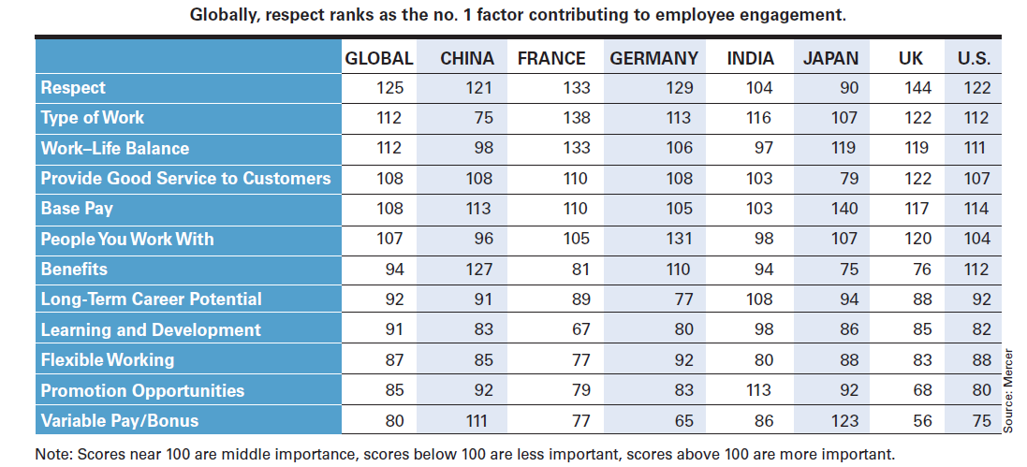
Exhibit 14-2: Key Employee
Engagement Factors
Notes:
Highly engaged employees are passionate about and deeply connected to their work. Disengaged employees have essentially “checked out” and don’t care. They show up for work, but have no energy or passion for it. Exhibit 14-2 lists the key engagement factors found in a global study of more than 12,000 employees.

Slide 8
Job Satisfaction
Job satisfaction - an employee’s general attitude toward his or her job.
Workplace misbehavior - any intentional employee behavior that is potentially damaging to the organization or to individuals within the organization.
Attitudes - evaluative statements, either favorable or unfavorable, concerning objects, people, or events.

Slide 9
Job Satisfaction (cont.)
Cognitive component - that part of an attitude that’s made up of the beliefs, opinions, knowledge, or information held by a person.
Affective component - that part of an attitude that’s the emotional or feeling part.
Behavioral component - that part of an attitude that refers to an intention to behave in a certain way toward someone or something.

Slide 10
Job Involvement and Organizational Commitment
Job involvement - the degree to which an employee identifies with his or her job, actively participates in it, and considers his or her job performance to be important to self-worth.
Organizational commitment - the degree to which an employee identifies with a particular organization and its goals and wishes to maintain membership in that organization.

Slide 11
Organizational Commitment
Perceived organizational support - employees’ general belief that their organization values their contribution and cares about their well-being.

Slide 12
Employee Engagement
Employee engagement - when employees are connected to, satisfied with, and enthusiastic about their jobs.
Cognitive dissonance - any incompatibility or inconsistency between attitudes or between behavior and attitudes.
Attitude surveys - surveys that elicit responses from employees through questions about how they feel about their jobs, work groups, supervisors, or the organization.

Slide 13
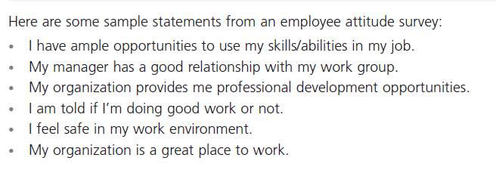
Exhibit 14-3: Sample Employee
Attitude Survey
Notes:
Many organizations regularly survey their employees about their attitudes. Exhibit 14-3 shows an example of an actual attitude survey.

Slide 14
Personality
Personality - the unique combination of emotional, thought, and behavioral patterns that affect how a person reacts to situations and interacts with others.
Big Five Model - personality trait model that includes extraversion, agreeableness, conscientiousness, emotional stability, and openness to experience.

Slide 15
Other Personality Traits
Machiavellianism - a measure of the degree to which people are pragmatic, maintain emotional distance, and believe that ends justify means.
Self-esteem - an individual’s degree of like or dislike for him/herself.
Self-monitoring - a personality trait that measures the ability to adjust behavior to external situational factors.

Slide 16
Big Five Model
Extraversion: The degree to which someone is sociable, talkative, assertive, and comfortable in relationships with others.
Agreeableness: The degree to which someone is goodnatured, cooperative, and trusting.
Conscientiousness: The degree to which someone is reliable, responsible, dependable, persistent, and achievement oriented.
Emotional stability: The degree to which someone is calm, enthusiastic, and secure (positive) or tense, nervous, depressed, and insecure (negative).
Openness to experience: The degree to which someone has a wide range of interests and is imaginative, fascinated with novelty, artistically sensitive, and intellectual.

Slide 17
Other Personality Traits (cont.)
Proactive personality - a trait belonging to people who identify opportunities, show initiative, take action, and persevere until meaningful change occurs.
Resilience - an individual’s ability to overcome challenges and turn them into opportunities.

Slide 18
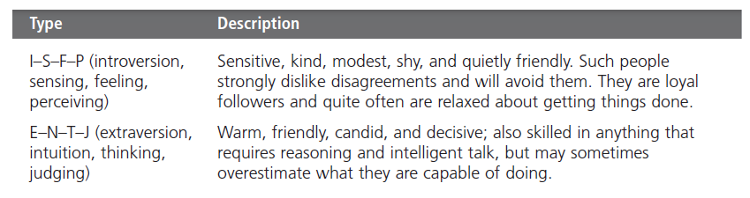
Exhibit 14-4: Examples of MBTI®
Personality Types
Notes:
MBTI: Myers Briggs Type Indicator
Combining these preferences provides descriptions of 16 personality types, with every person identified with one of the items in each of the four pairs. Exhibit 14-4 summarizes two of them. As you can see from these descriptions, each personality type would approach work and relationships differently—neither one better than the other, just different.

Slide 19
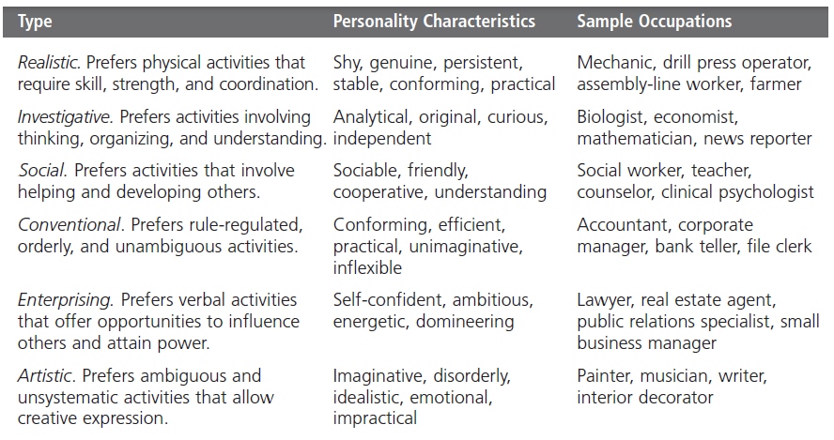
Exhibit 14-5: Holland’s Personality-Job Fit
Notes:
The best-documented personality-job fit theory was developed by psychologist John Holland, who identified six basic personality types. His theory states that an employee’s satisfaction with his or her job, as well as his or her likelihood of leaving that job, depends on the degree to which the individual’s personality matches the job environment. Exhibit 14-5 describes the six types, their personality characteristics, and examples of suitable occupations for each.

Slide 20
Emotions and Emotional Intelligence
Emotions - intense feelings that are directed at someone or something.
Emotional Intelligence (EI) - the ability to notice and to manage emotional cues and information.

Slide 21
Perception
Perception - a process by which we give meaning to our environment by organizing and interpreting sensory impressions.

Slide 22
How We Perceive People
Attribution Theory - how the actions of individuals are perceived by others depends on what meaning (causation) we attribute to a given behavior.
  Internally caused behavior: under the individual’s control
  Externally caused behavior: due to outside factors

Slide 23
How We Perceive People (cont.)
Fundamental attribution error - the tendency to underestimate the influence of external factors and to overestimate the influence of internal or personal factors.
Self-serving bias - the tendency of individuals to attribute their successes to internal factors while blaming personal failures on external factors.

Slide 24

Perception Exercise
If your eyes follow the movement of the rotating pink dot, the dots will remain only one color, pink.
However if you stare at the black '+' in the center, the moving dot turns to green.
Now, concentrate on the black '+' in the center of the picture. After a short period, all the pink dots will slowly disappear, and you will only see only a single green dot rotating.

Slide 25
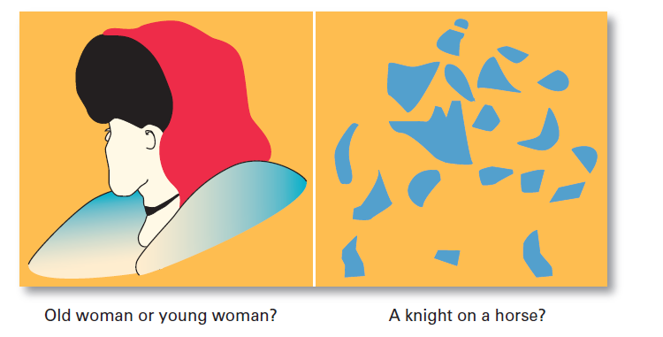
Exhibit 14-6: What Do You See?
Notes:
The relationship of a target to its background also influences perception, as does our tendency to group close things and similar things together. You can experience these tendencies by looking at the visual perception examples shown in Exhibit 14-6. Notice how what you see changes as you look differently at each one.

Slide 26
Shortcuts Used in Judging Others
Assumed similarity - the assumption that others are like oneself.
Stereotyping - judging a person on the basis of one’s perception of a group to which he or she belongs.
Halo effect - a general impression of an individual based on a single characteristic.

Slide 27
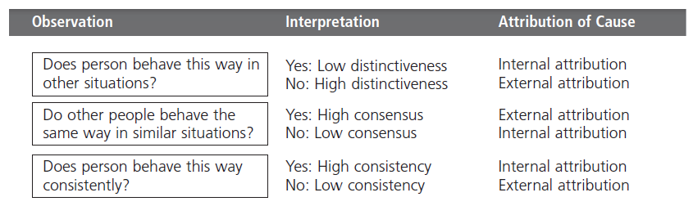
Exhibit 14-7: Attribution Theory
Notes:
The more consistent the behavior, the more the observer is inclined to attribute it to internal causes. Exhibit 14-7 summarizes the key elements of attribution theory.

Slide 28
Psychological Factors – Learning
Learning - any relatively permanent change in behavior that occurs as a result of experience.
    Almost all complex behavior is learned.
    Learning is a continuous, life-long process.
    The principles of learning can be used to shape behavior.
Theories of learning:
  Operant conditioning
  Social learning

Slide 29
Operant Conditioning
Operant conditioning - a theory of learning that says behavior is a function of its consequences
  Operant behavior: voluntary or learned behaviors
    Behaviors are learned by making rewards contingent to behaviors.
    Behavior that is rewarded (positively reinforced) is likely to be repeated.
    Behavior that is punished or ignored is less likely to be repeated.

Slide 30
Social Learning
Social learning theory - a theory of learning that says people can learn through observation and direct experience.
    Attentional: the attractiveness or similarity of the model
    Retention: how well the model can be recalled
    Motor reproduction: the reproducibility of the model’s actions
    Reinforcement: the rewards associated with learning the model behavior

Slide 31
Shaping: A Managerial Tool
Shaping behavior - the process of guiding learning in graduated steps using reinforcement or lack of reinforcement.
  Shaping methods:
    Positive reinforcement: rewarding desired behaviors
    Negative reinforcement: removing an unpleasant consequence once the desired behavior is exhibited
    Punishment: penalizing an undesired behavior
    Extinction: eliminating a reinforcement for an undesired behavior

Slide 32
Contemporary Issues in Organization Behavior
Managing Generational Differences in the Workplace
  Gen Y: individuals born after 1978
    Bring new attitudes to the workplace that reflect wide arrays of experiences and opportunities
    Want to work, but don’t want work to be their life
    Challenge the status quo
    Have grown up with technology
Managing Negative Behavior in the Workplace

Slide 33
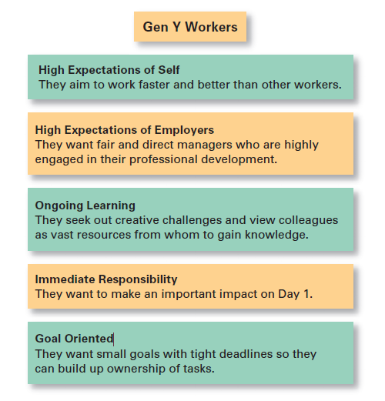
Exhibit 14-8: Gen Y Workers
Notes:
There’s no consensus about the exact time span that Gen Y comprises, but most definitions include those individuals born from about 1982 to 1997. One thing is for sure—they’re bringing new attitudes with them to the workplace. Gen Ys have grown up with an amazing array of experiences and opportunities. And they want their work life to provide that as well, as shown in Exhibit 14-8.

Slide 34
Terms to Know
behavior
organizational behavior
employee productivity
absenteeism
turnover
organizational citizenship behavior
job satisfaction
workplace misbehavior
attitudes
cognitive component
affective component
behavioral component
job involvement
organizational commitment
perceived organizational support
cognitive dissonance
attitude surveys
personality
Big Five Model
locus of control
Machiavellianism

Slide 35
